Slide 1
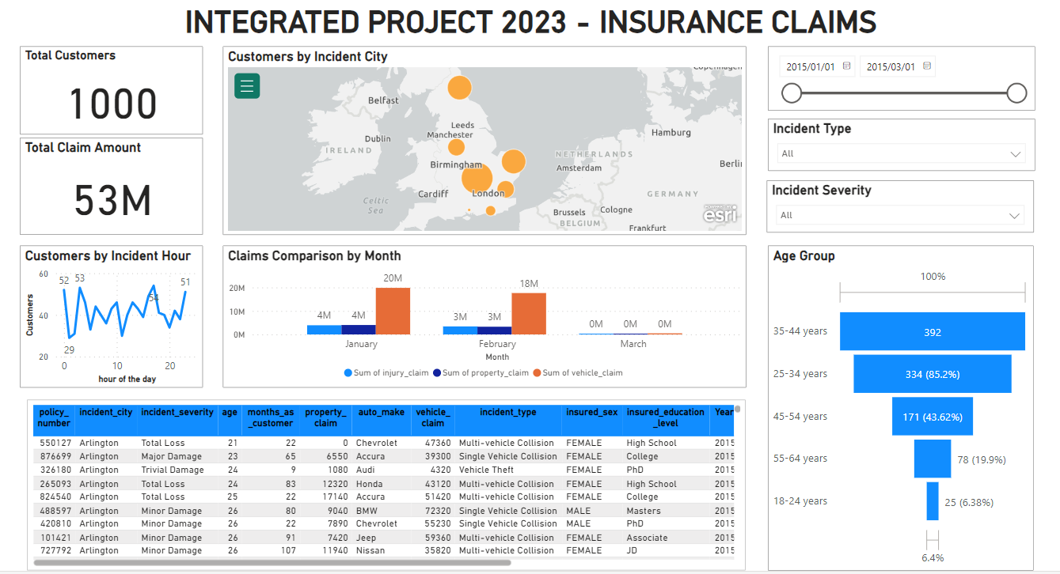

Microsoft Power BI – Integrated Project 2023 – Explore AI – Insurance Claims

Slide 2
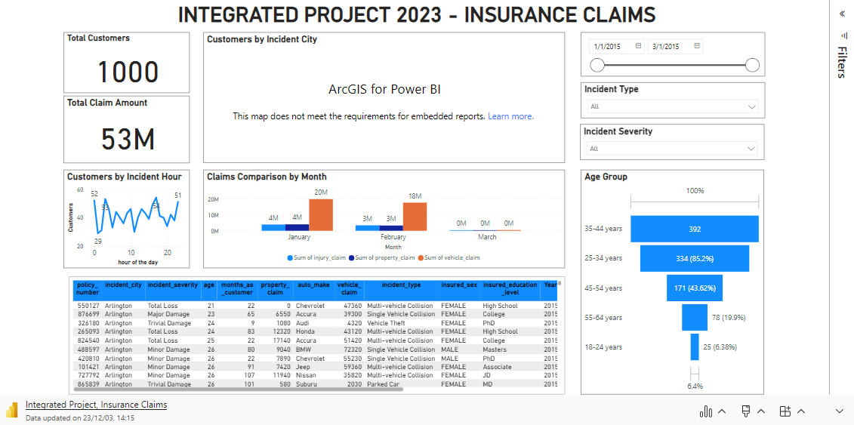
Microsoft Power BI – Integrated Project 2023 – Explore AI – Insurance Claims

